Slide 1
SOURCES OF INDOOR POLLUTANTS

Slide 2
Outline
Pollutants and their Sources
Indoor Air Pollution in Nepal
Summary

Slide 3
People in general spend
“ approximately 90% “
of their time breathing indoor air

Slide 4
According to WHO,
“ 4.3 million people “
a year die from the exposure to household air pollution

Slide 5
WHO emphasizes
“ rule of 1000 ”
which states that when a pollutant is released indoors, it is 1000 times more likely to reach people’s lungs than a pollutant released outdoors

Slide 6
Health Effects Related to Pollutants
Suspended particulate matter | Eye, nose and throat irritation; headache; respiratory infections and bronchitis; lung cancer
Sulfur dioxide | Respiratory irritation, increased resp. infections in children
Nitric oxides | Respiratory irritation, increased resp. infections in children
Photo-oxidants | Higher incidence of infection; decrements in pulmonary function in children, allergic reactions;
Volatile organic compounds | Resp. irritation, headache and loss of co ordination; damage to liver, kidney and brain, cancer…
Carbon monoxide | headache; impaired vision and mental functioning and vascular changes, angina pectoris status.

Slide 7
COMBUSTION PRODUCTS
Carbon monoxide (CO)
Nitrogen dioxide (NO₂)
Sulfur dioxide (SO₂)
Nitrogenated compounds (NO_{x})
Particulate matter (PM)

Slide 8
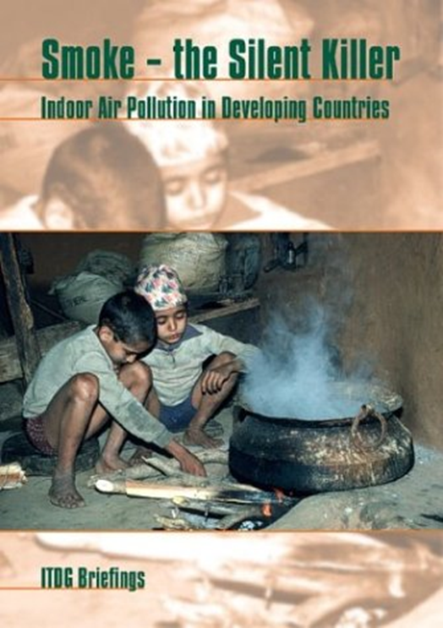
MAJOR SOURCES
Gas stoves and appliances
Wood and coal stoves
Gas and propane engines
Fireplaces
Tobacco smoke
Candles and incense
Mosquito coils, etc.

Slide 9
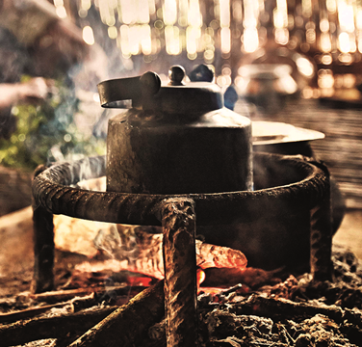
CARBONMONOOXIDE (CO) “ A Silent Killer “
MAIN SOURCE IS INCOMPLETE COMBUSTION
Gas, kerosene, wood stoves and coal
Fires, fireplaces, furnaces
Leaking chimneys and vents
Room and water heaters
Vehicle exhaust in closed garage
Tobacco smoke

Slide 10
VOLATILE ORGANIC COMPOUND (VOCs)
Alkanes
Aromatic Hydrocarbons
Alcohols
Aldehydes
Ketones, etc.

Slide 11

VOCs Sources
MAINLY FROM CONSUMER PRODUCTS
Solvents, fabric softeners, deodorizers and cleaning products
Paints, glues, resins, waxes and polishing materials
Spray propellants, dry cleaning fluids
Pens and markers
Binders and plasticizers
Cosmetics: hair sprays, perfumes

Slide 12
FORMALDEHYDE
Developing countries
Use of solid fuels indoors
Mosquito coils
Furniture (pressed wood)
Industrialized countries
Household cleaners and deodorizers
Glues and resins
Tobacco smoke
Carpeting
Furniture and dyed materials
Pressed wood products
Urea formaldehyde insulating foam (UFFI)
Others

Slide 13
BIOLOGICAL POLLUTANTS
Molds
Bacteria
Dust Mites
Animal allergens

Slide 14
MAJOR SOURCES
Water-damaged surfaces and materials
Humidifiers and stagnant water
Water vapour from cooking and showering
Air conditioning systems
Mattresses, upholstered furniture and carpets
Dirt

Slide 15
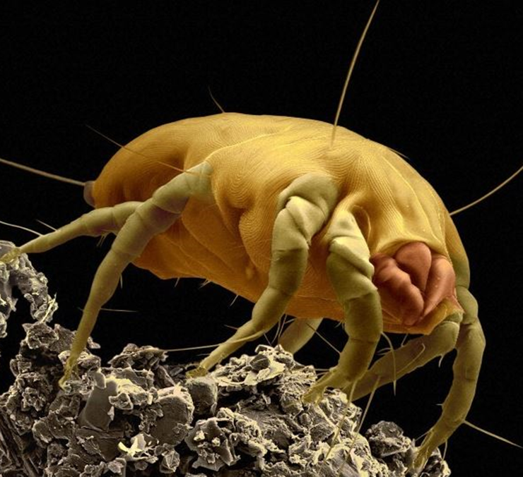
DUST MITES
Feed on human dander
Prefer warm, humid environments
Sources:
bedding, carpets, upholstery, soft toys

Slide 16

ANIMAL ALLERGENS
Cat dander (most allergenic)
Dog dander
Birds
Cockroach parts and feces

Slide 17
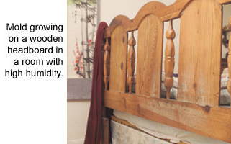
MOULDS
Dampness
High Humidity

Slide 18
OTHER
Asbestos
Radon
Lead
Ozone
POPs

Slide 19
ASBESTOS
Used in Building materials and Automotive industry
Most commonly found in coatings, paints, building materials, and ceiling and floor tiles
Major route of exposure is Inhalation
Fibres liberated From deterioration or renovation of asbestos containing materials

Slide 20
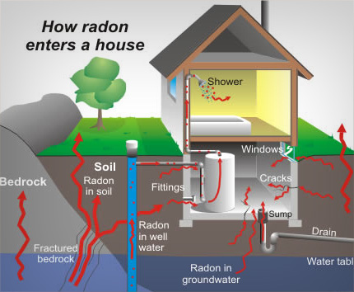
RADON
Radioactive gas released from soil and rocks
Produced from the natural breakdown of thorium and uranium found in most rocks and soils
Concentrations indoors depend on construction site and building materials

Slide 21
OZONE
Photocopier
Printer

Slide 22
PERSISTENT ORGANIC POLLUTANTS (POPs)
Brominated flame retardants (BFRs)
Polycyclic aromatic hydrocarbons (PAHs)

Slide 23
MAJOR SOURCES
Cables, computers, TVs and household textiles
Fuel/tobacco combustion, fumes from food, e.g. from cooking oil

Slide 24
INDOOR AIR POLLUTION IN NEPAL

Slide 25
The WHO Report-2002
Indoor air pollution from solid fuels is the fourth most important health risk factor in
THE LEAST DEVELOPED COUNTRIES,
where 40% of the world’s population (about 3.5 billion) lives
About 6% of all deaths each year

Slide 28
Annually,
7500 premature deaths
occur in Nepal due to Indoor
Air Pollution by solid biomass burning

Slide 29
 | Prevailing | National Standard
Particulate Matter (PM₁₀) (in 24 hrs avg. time) | 8000 μg/m3 | 120 μg/m3
Total Suspended Matter (TSP) | 8,800 μg/m3 | 230 μg/m3
Carbon Monoxide (CO) (in 8 hrs avg.) | 21 ppm | 9 ppm
Source: Lohani, S.P. (2011). Biomass as a Source of Household Energy and Indoor Air Pollution in Nepal. Iranica Journal of Energy & Environment 2 (1): 74-78.

Slide 30
THANK YOU !!!

